Slide 1
Information Retrieval and Web Search
Vasile Rus, PhD
vrus@memphis.edu
www.cs.memphis.edu/~vrus/teaching/ir-websearch/

Slide 2
Outline
More on Text Categorization

Slide 3
Categorization/Classification
Given:
  A description of an instance, x∈X, where X is the instance language or instance space
    Issue: how to represent text documents
  A fixed set of categories:
  C = {c₁, c₂,…, c_{n}}
Determine:
  The category of x: c(x)∈C, where c(x) is a categorization function whose domain is X and whose range is C
    We want to know how to build categorization functions (“classifiers”).

Slide 4
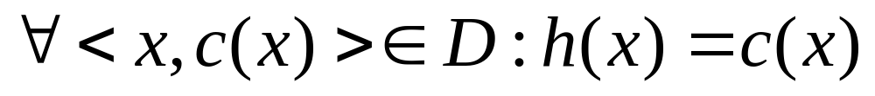
Learning for Categorization
A training example is an instance x∈X, paired with its correct category c(x): <x, c(x)> for an unknown categorization function, c
Given a set of training examples, D
Find a hypothesized categorization function, h(x), such that:
Consistency

Slide 5
Learning for Text Categorization
Manual development of text categorization functions is difficult
Learning Algorithms:
  Bayesian (naïve)
  Neural network
  Relevance Feedback (Rocchio)
  Nearest Neighbor (case based)
  Support Vector Machines (SVM)

Slide 6
Bayesian Methods
Learning and classification methods based on probability theory
Bayes theorem plays a critical role in probabilistic learning and classification
Uses prior probability of each category given no information about an item
Categorization produces a posterior probability distribution over the possible categories given a description of an item

Slide 7
Bayesian Inference
Use evidence to change the degree of belief in a hypothesis
  A two-face coin
    Hypothesis: Heads – 50%; Tails – 50%
  After 100 tosses you notice the head came up 95 times
    Change the hypothesis based on the new evidence

Slide 8
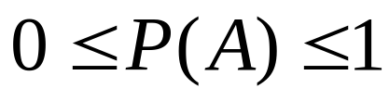

Axioms of Probability Theory
All probabilities between 0 and 1
True proposition has probability 1, false has probability 0
P(true) = 1 P(false) = 0
The probability of disjunction is:
A
B

Slide 9
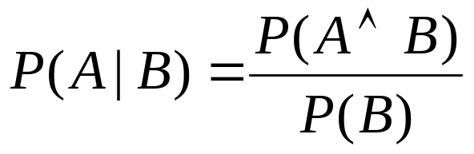
Conditional Probability
P(A | B) is the probability of A given B
Assumes that B is all and only information known
Defined by:
A
B

Slide 10


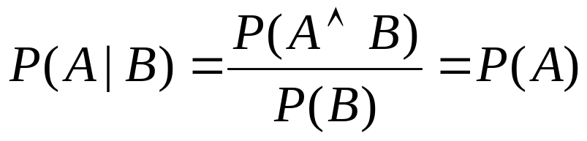
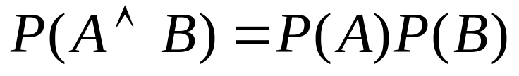
Independence
A and B are independent iff:
Therefore, if A and B are independent:
These two constraints are logically equivalent

Slide 11
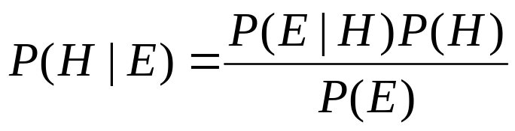
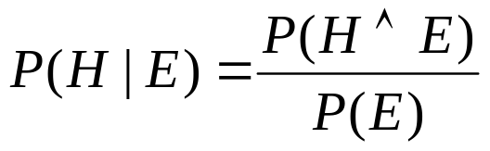
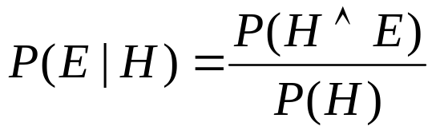

Bayes Theorem
Simple proof from definition of conditional probability:
(Def. cond. prob.)
(Def. cond. prob.)
QED:

Slide 12
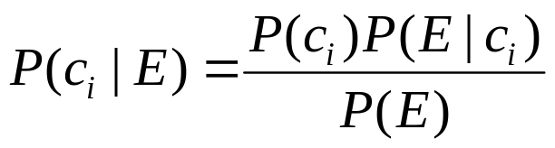
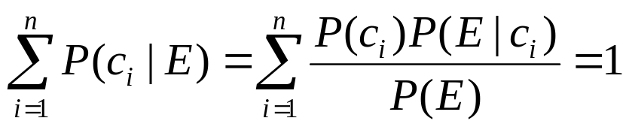
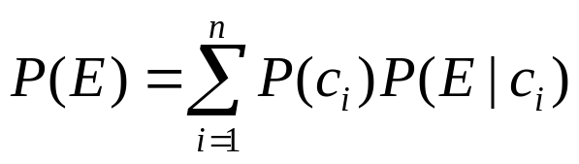
Bayesian Categorization
Let set of categories be {c₁, c₂,…c_{n}}
Let E be description of an instance (Evidence)
Determine category of E by determining for each c_{i}
P(E) can be determined since categories are complete and disjoint

Slide 13
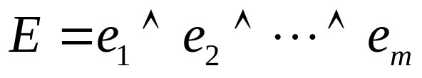
Bayesian Categorization (cont.)
Need to know:
  Priors: P(c_{i})
  Conditionals: P(E | c_{i})
P(c_{i}) are easily estimated from data
  If n_{i} of the examples in D are in c_{i},then P(c_{i}) = n_{i} / |D|
Assume instance is a conjunction of binary features:
Too many possible instances (exponential in m) to estimate all P(E | c_{i})

Slide 14
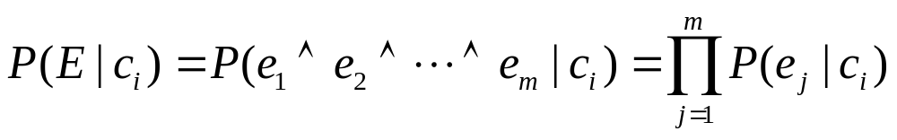
Naïve Bayesian Categorization
If we assume features of an instance are independent given the category (c_{i}) (conditionally independent)
Therefore, we then only need to know P(e_{j} | c_{i}) for each feature and category

Slide 15
Naïve Bayes Example
C = {allergy, cold, well}
e₁ = sneeze; e₂ = cough; e₃ = fever
E = {sneeze, cough, ¬fever}
Prob | Well | Cold | Allergy
P(c_{i}) | 0.9 | 0.05 | 0.05
P(sneeze|c_{i}) | 0.1 | 0.9 | 0.9
P(cough|c_{i}) | 0.1 | 0.8 | 0.7
P(fever|c_{i}) | 0.01 | 0.7 | 0.4

Slide 16
Naïve Bayes Example (cont.)
P(well | E) = (0.9)(0.1)(0.1)(0.99)/P(E)=0.0089/P(E)
P(cold | E) = (0.05)(0.9)(0.8)(0.3)/P(E)=0.01/P(E)
P(allergy | E) = (0.05)(0.9)(0.7)(0.6)/P(E)=0.019/P(E)
Most probable category: allergy
P(E) = 0.0089 + 0.01 + 0.019 = 0.0379
P(well | E) = 0.23
P(cold | E) = 0.26
P(allergy | E) = 0.50
Probability | Well | Cold | Allergy
P(c_{i}) | 0.9 | 0.05 | 0.05
P(sneeze | c_{i}) | 0.1 | 0.9 | 0.9
P(cough | c_{i}) | 0.1 | 0.8 | 0.7
P(fever | c_{i}) | 0.01 | 0.7 | 0.4
E={sneeze, cough, ¬fever}

Slide 17
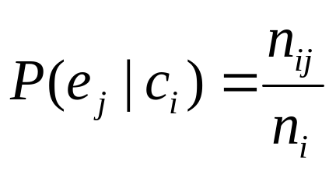
Estimating Probabilities
Normally, probabilities are estimated based on observed frequencies in the training data
If D contains n_{i} examples in category c_{i}, and n_{ij} of these n_{i} examples contains feature e_{j}, then:
However, estimating such probabilities from small training sets is error-prone
If due only to chance, a rare feature, e_{k}, is always false in the training data, ∀c_{i} :P(e_{k} | c_{i}) = 0
If e_{k} then occurs in a test example, E, the result is that ∀c_{i}: P(E | c_{i}) = 0 and ∀c_{i}: P(c_{i} | E) = 0

Slide 18
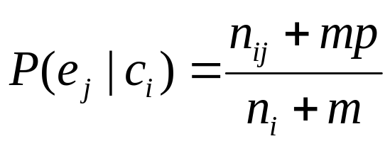
Smoothing
To account for estimation from small samples, probability estimates are adjusted or smoothed
Laplace smoothing using an m-estimate assumes that each feature is given a prior probability, p, that is assumed to have been previously observed in a “virtual” sample of size m
For binary features, p is simply assumed to be 0.5

Slide 19
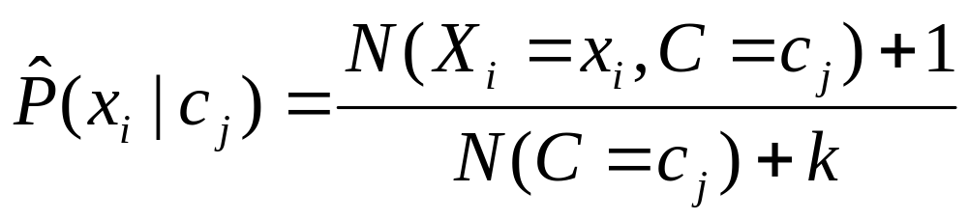
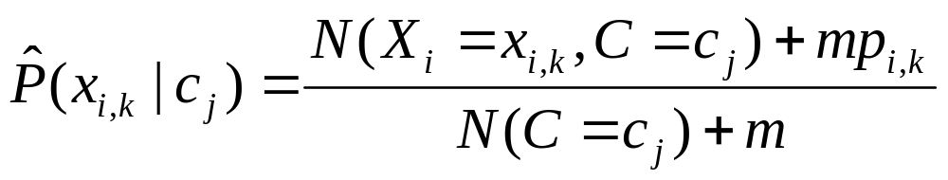
Smoothing to Avoid Overfitting
# of values of X_{i}
Somewhat more subtle version
overall fraction in data where X_{i}=x_{i,k}
extent of
“smoothing”

Slide 20
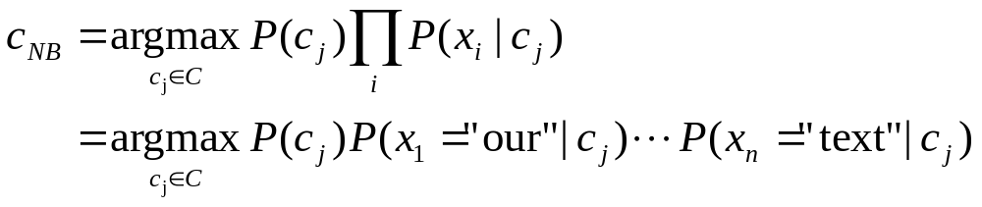
Using Naive Bayes Classifiers to Classify Text: Basic method
Attributes are text positions, values are words
Still too many possibilities
Assume that classification is independent of the positions of the words
  Use same parameters for each position

Slide 21
Naïve Bayes for Text
Modeled as generating a bag of words for a document in a given category by repeatedly sampling with replacement from a vocabulary V = {w₁, w₂,…w_{m}} based on the probabilities P(w_{j} | c_{i})
Smooth probability estimates with Laplace m-estimates assuming a uniform distribution over all words (p = 1/|V|) and m = |V|
  Equivalent to a virtual sample of seeing each word in each category exactly once

Slide 22
Text Naïve Bayes Algorithm
(Train)
Let V be the vocabulary of all words in the documents in D
For each category c_{i} ∈ C
Let D_{i} be the subset of documents in D in category c_{i}
P(c_{i}) = |D_{i}| / |D|
Let T_{i} be the concatenation of all the documents in D_{i}
Let n_{i} be the total number of word occurrences in T_{i}
For each word w_{j} ∈ V
Let n_{ij} be the number of occurrences of w_{j} in T_{i}
Let P(w_{i} | c_{i}) = (n_{ij} + 1) / (n_{i} + |V|)

Slide 23
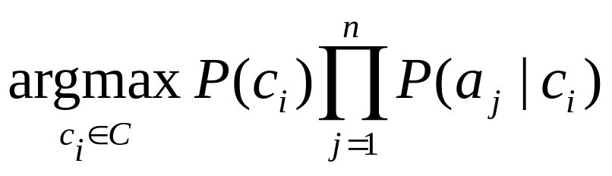
Text Naïve Bayes Algorithm
(Test)
Given a test document X
Let n be the number of word occurrences in X
Return the category:
where a_{j} is the word occurring in the jth position in X

Slide 24
Naïve Bayes Time Complexity
Training Time: O(|D|L_{d} + |C||V|)) where L_{d} is the average length of a document in D.
  Assumes V and all D_{i} , n_{i}, and n_{ij} pre-computed in O(|D|L_{d}) time during one pass through all of the data
  Generally just O(|D|L_{d}) since usually |C||V| < |D|L_{d}
Test Time: O(|C| L_{t}) where L_{t} is the average length of a test document
Very efficient overall, linearly proportional to the time needed to just read in all the data
Similar to Rocchio time complexity

Slide 25
Underflow Prevention
Multiplying lots of probabilities, which are between 0 and 1 by definition, can result in floating-point underflow
Since log(xy) = log(x) + log(y), it is better to perform all computations by summing logs of probabilities rather than multiplying probabilities
Class with highest final un-normalized log probability score is still the most probable

Slide 26
Naïve Bayes Posterior Probabilities
Classification results of naïve Bayes (the class with maximum posterior probability) are usually fairly accurate
However, due to the inadequacy of the conditional independence assumption, the actual posterior-probability numerical estimates are not
  Output probabilities are generally very close to 0 or 1

Slide 27
Summary
Text Categorization

Slide 28
Next
Text Clustering

